Slide 1
TRAFFIC RACING
Pesented By
Nahid Ibne Anwar
Md. Shahin Alom Shuvo

Slide 2
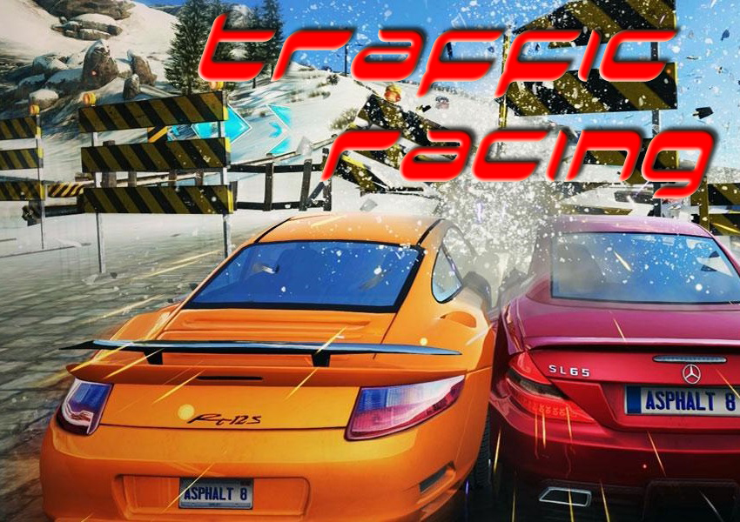
About Traffic Racing
Traffic Racing is a single
player game.
It is a car racing .
Wrote in C programming
language, with the help of
Borland Graphics Interface (BGI)
Compiled in CodeBlocks.

Slide 3
The objective of this project
Implementation of C language programming.
Learning basic level graphics operations.
Producing something with real life significance.
Use of modular programming was emphasized

Slide 4
Game Structure
MENU
EXIT GAME
NEW GAME
INSTRUCTION
SCORECARD
CREDITS
EXIT
LEVEL SELECT
PLAY

Slide 5
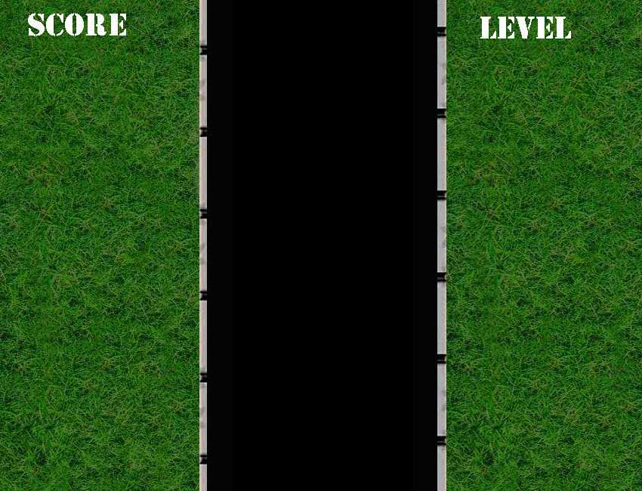
HOW TO PLAY?
In three lane, the player has to control a single car.
The player has to change the car’s lane in order to escape a collision.
Each escape results in one point.
Car speed increases with time when the level increases.
You can use jump to escape

Slide 6
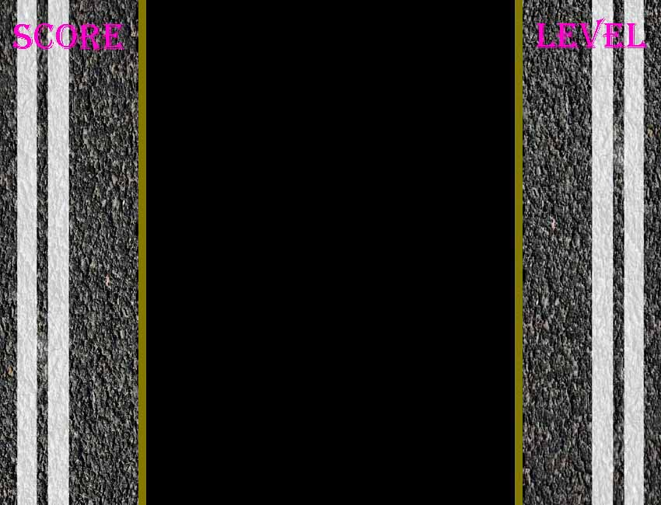
Five Lane
In five lane, the player has to control a single car.
The player has to change the car’s lane in order to escape a collision.
Each escape results in one point.
Car speed increases with time when the level increases.

Slide 7
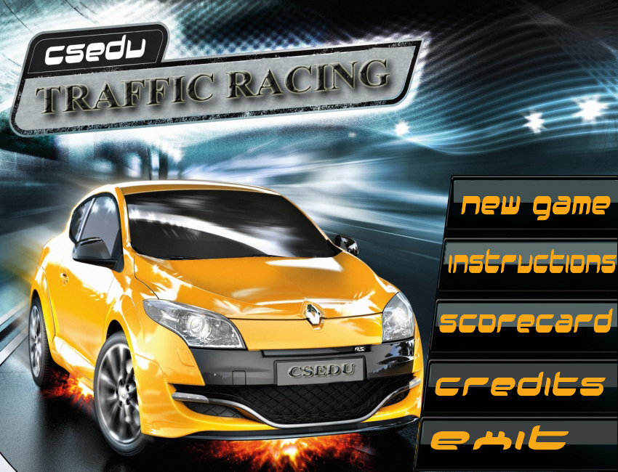
Interactive Menu
The game has an easy to use, interactive menu which responds to the user’s mouse operations.
Some part of the menu can also be controlled using the keyboard

Slide 8
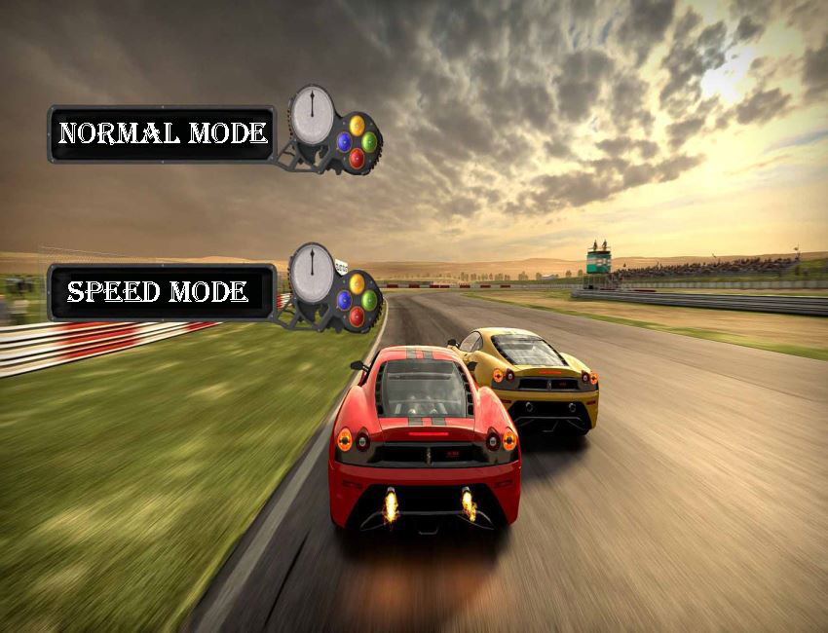
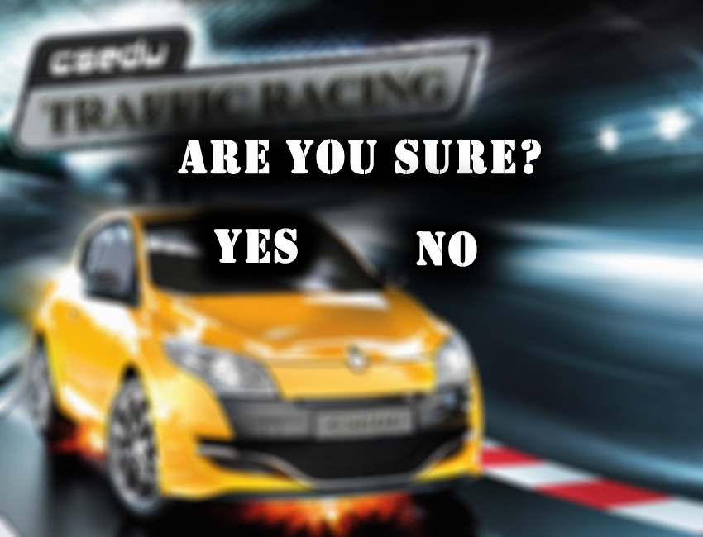
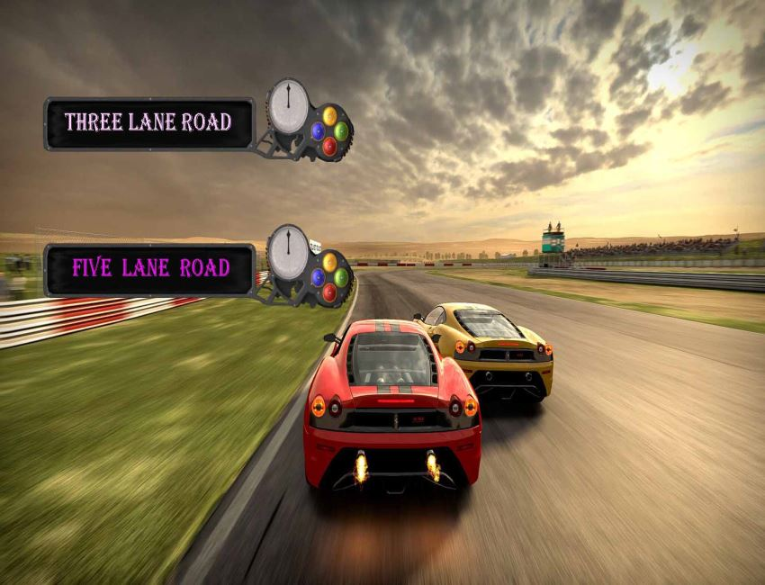
Menu Bars

Slide 9
Sound Effect
Sound effects were added by using the library winmm.lib
Sound effects make the game play very charmfull and interesting.

Slide 10
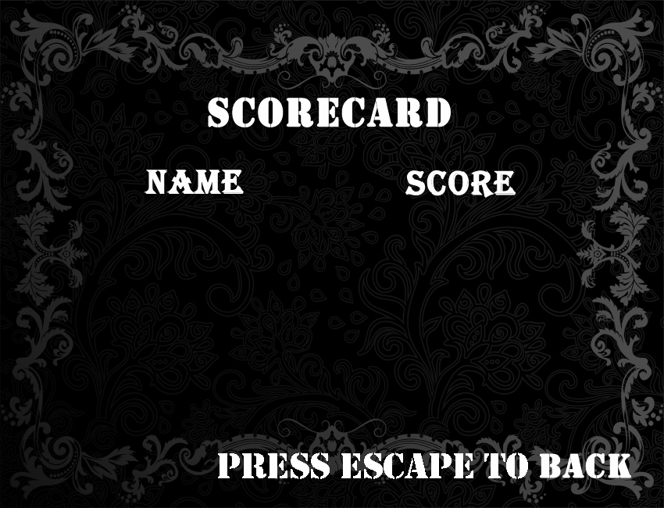
Scorecard and High Score
In the score card we save the top three high score with player name.
This make a sense of scoring more for go to leaderboard.

Slide 11

Bugs
No major bugs has been found so far in our games.

Slide 12
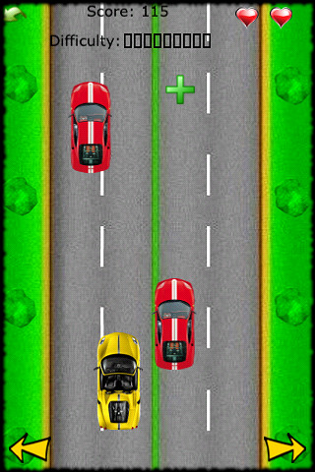
Idea Origination
Classical phone car racing game.
Nedd for speed.

Slide 13

Game Over
When the collision happened the game will over.

Slide 14


